Slide 1
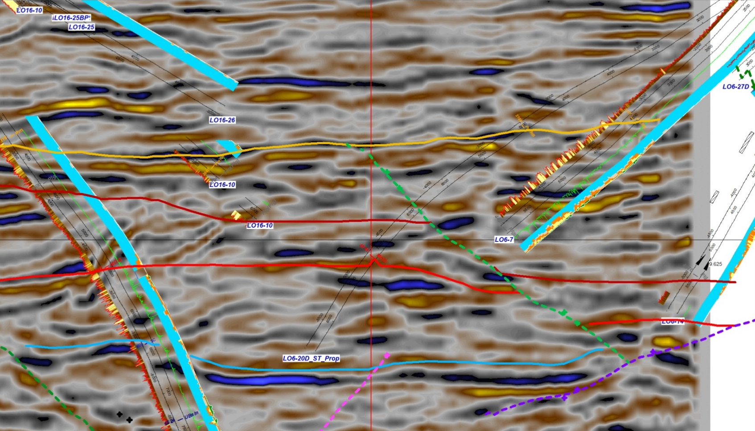
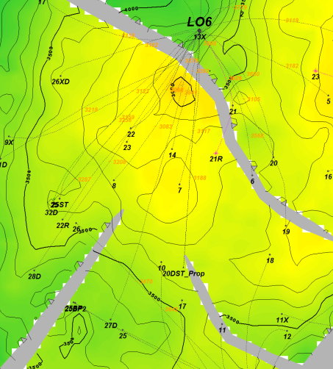
Block Z-2B
LO16 Project
3D Seismic Arb Line- Geomage PSTM
E.Borda Dec-2013
SW
NE
RioBravo
RioBravo
Palegreda
RioBravo
Palegreda
Mogollon
Mogollón
San Cristobal
LO6-34D_Prop
San Cristobal
Proposed well trajectory on well LO6-34D. This well considers Mogollon and Rio Bravo as main and secondary targets respectively.
Figure 4

Slide 2
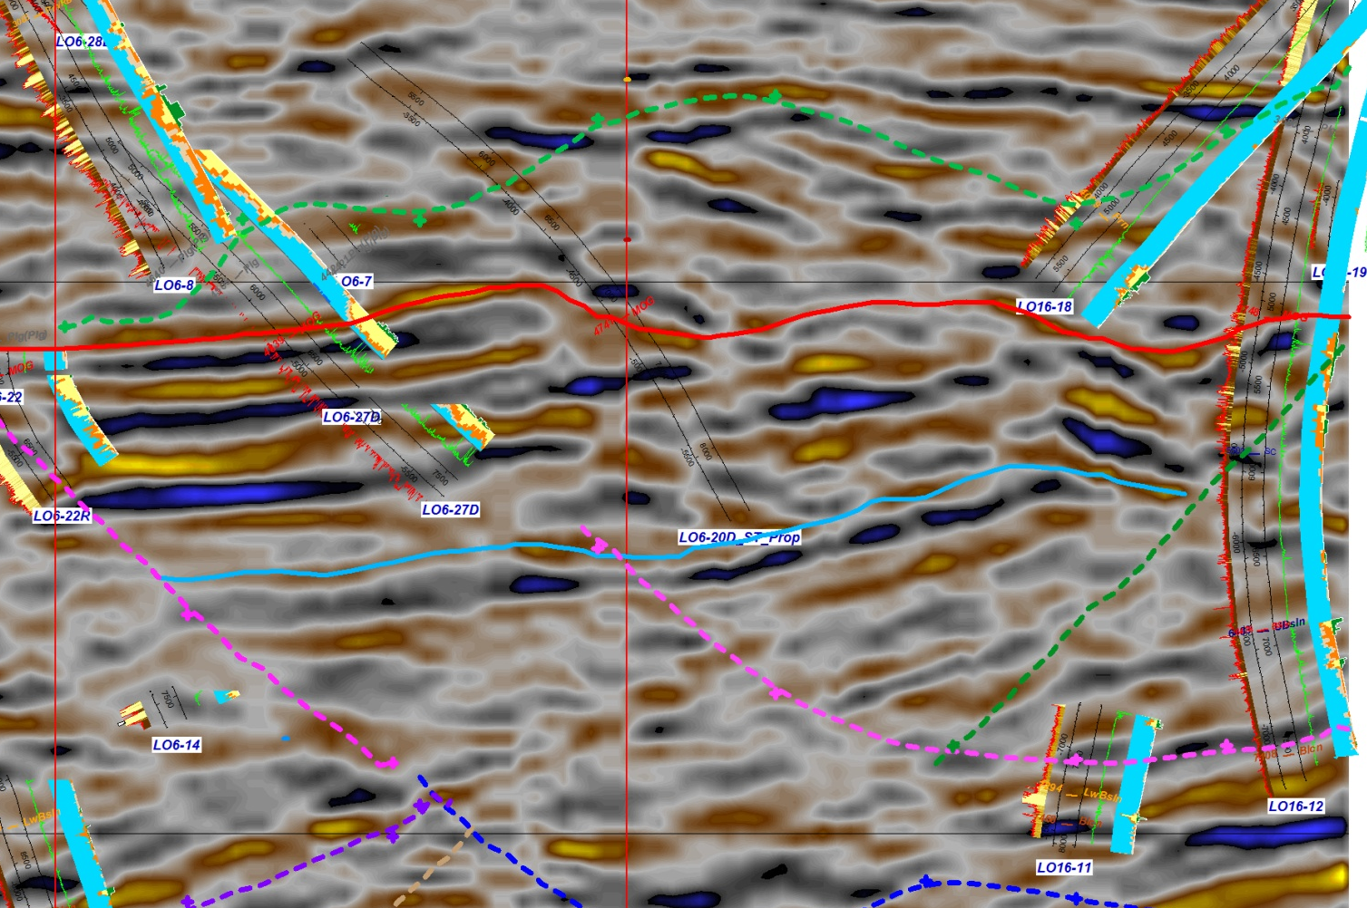
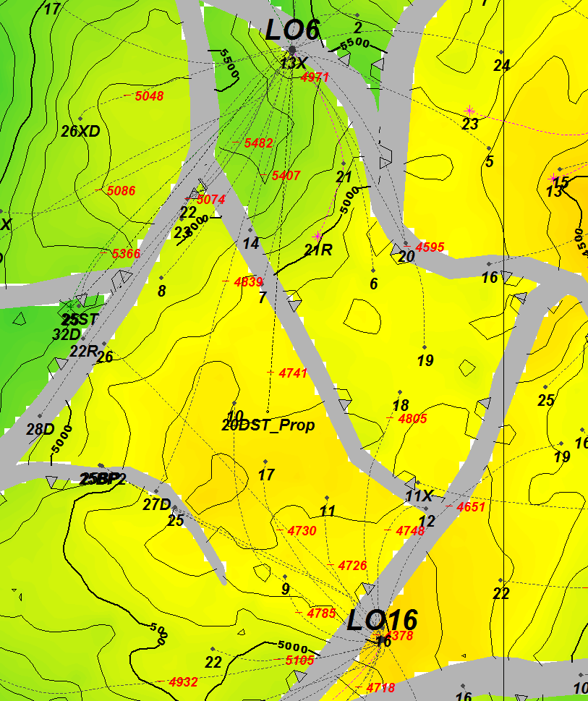
Block Z-2B
LO16 Project
3D Seismic Arb Line- Geomage PSTM
E.Borda Dec-2013
NW
SE
Mogollon
Mogollon
Mogollón
San Cristobal
San Cristobal
LO6-34D_Prop
San Cristobal
Arbitrary Seismic Line showing the correlation at the Mogollon and San Cristobal formations between wells and proposed LO6-34D
Figure 5

Slide 3
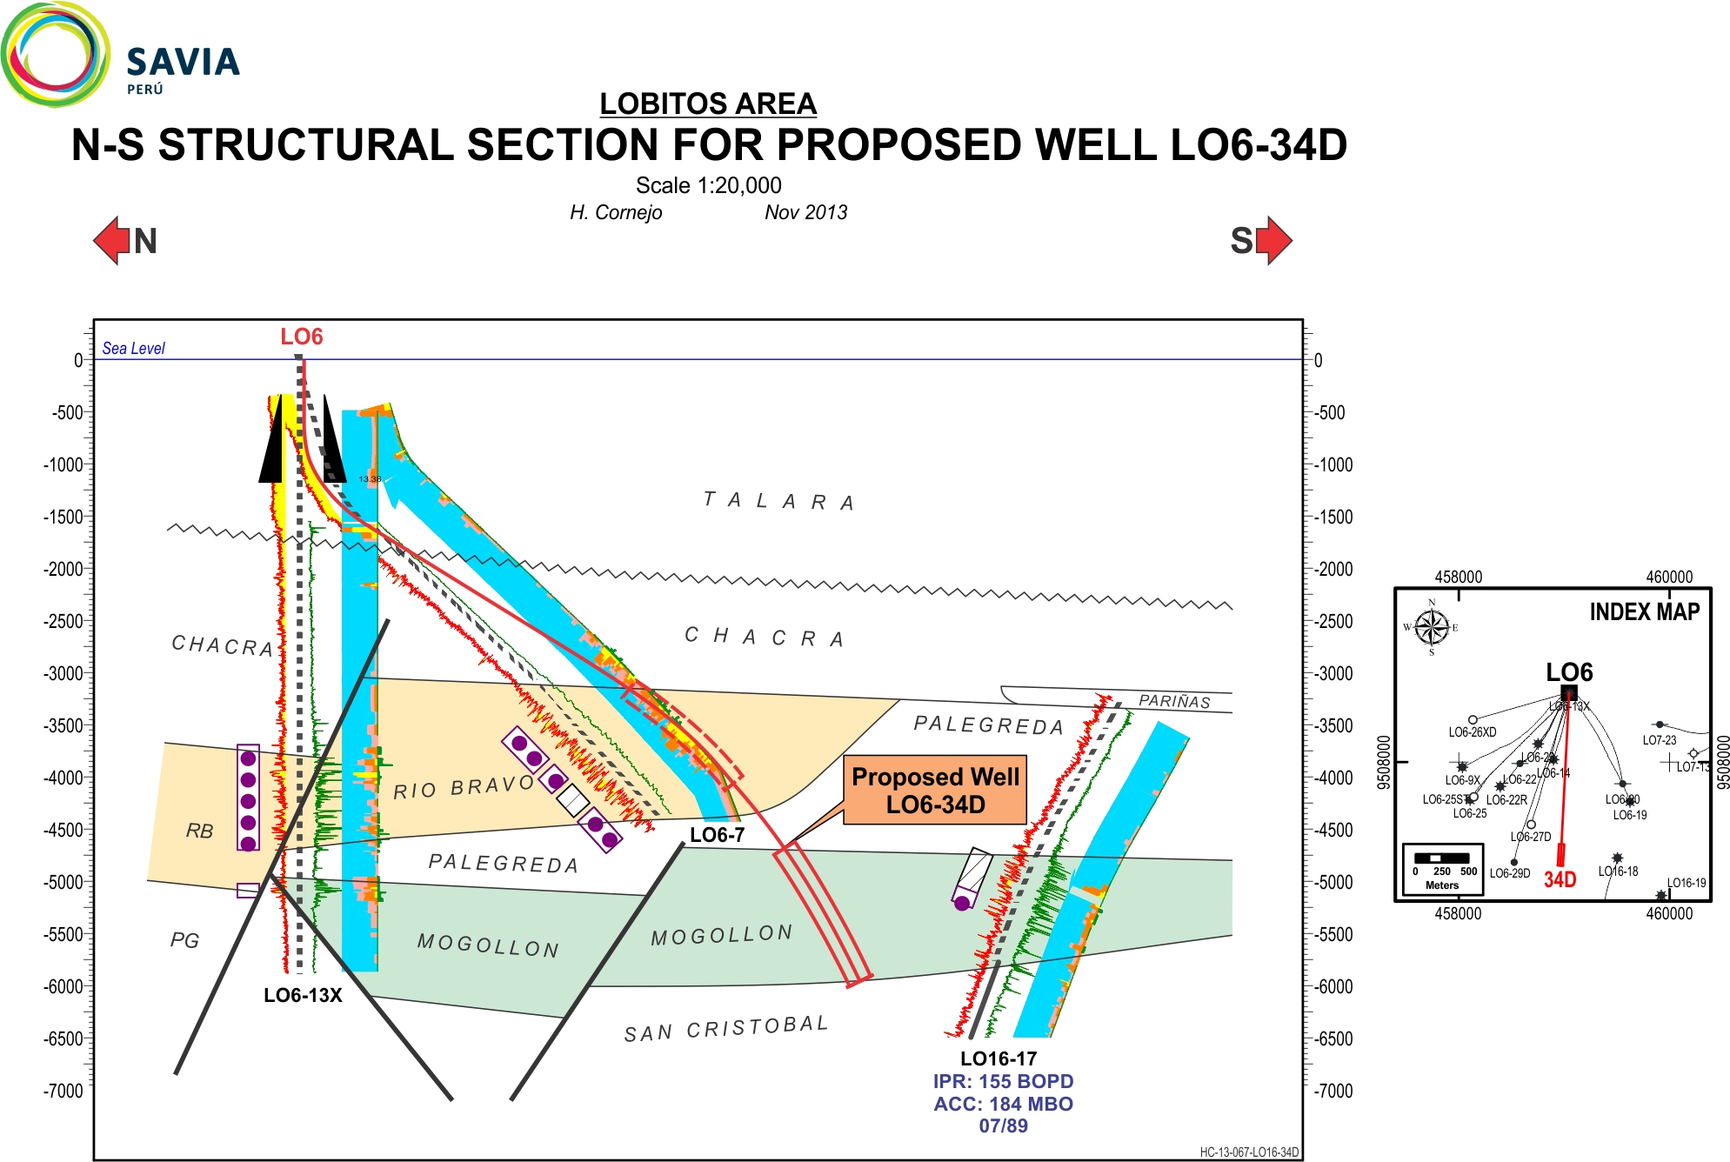
LOBITOS FIELD
NW-SE STRUCTURAL SECTION FOR PROPOSED WELL LO6-34D
Graphic Scale
H. Cornejo Dec. 2013
N
S
IPR: 125 BOPD
ACC: 37 MBO
06/84
IPR: 273 BOPD
ACC: 308 MBO
01/85
Figure 6

Slide 4
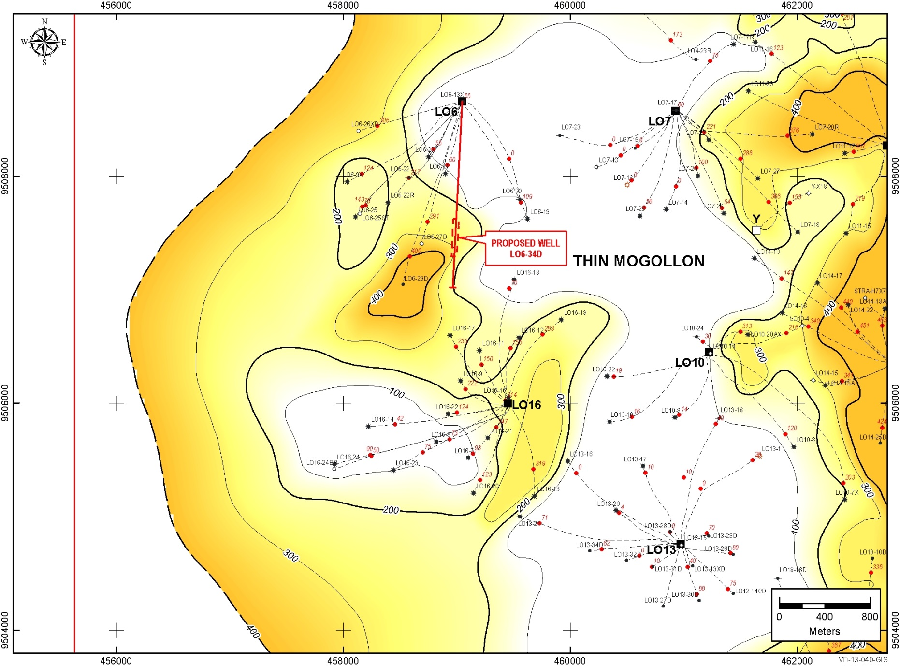
Z-2B LOBITOS FIELD
MOGOLLON FM. - GROSS SAND MAP
C. Canales / E. Coronado Dec 2013
Figure 7

Slide 5
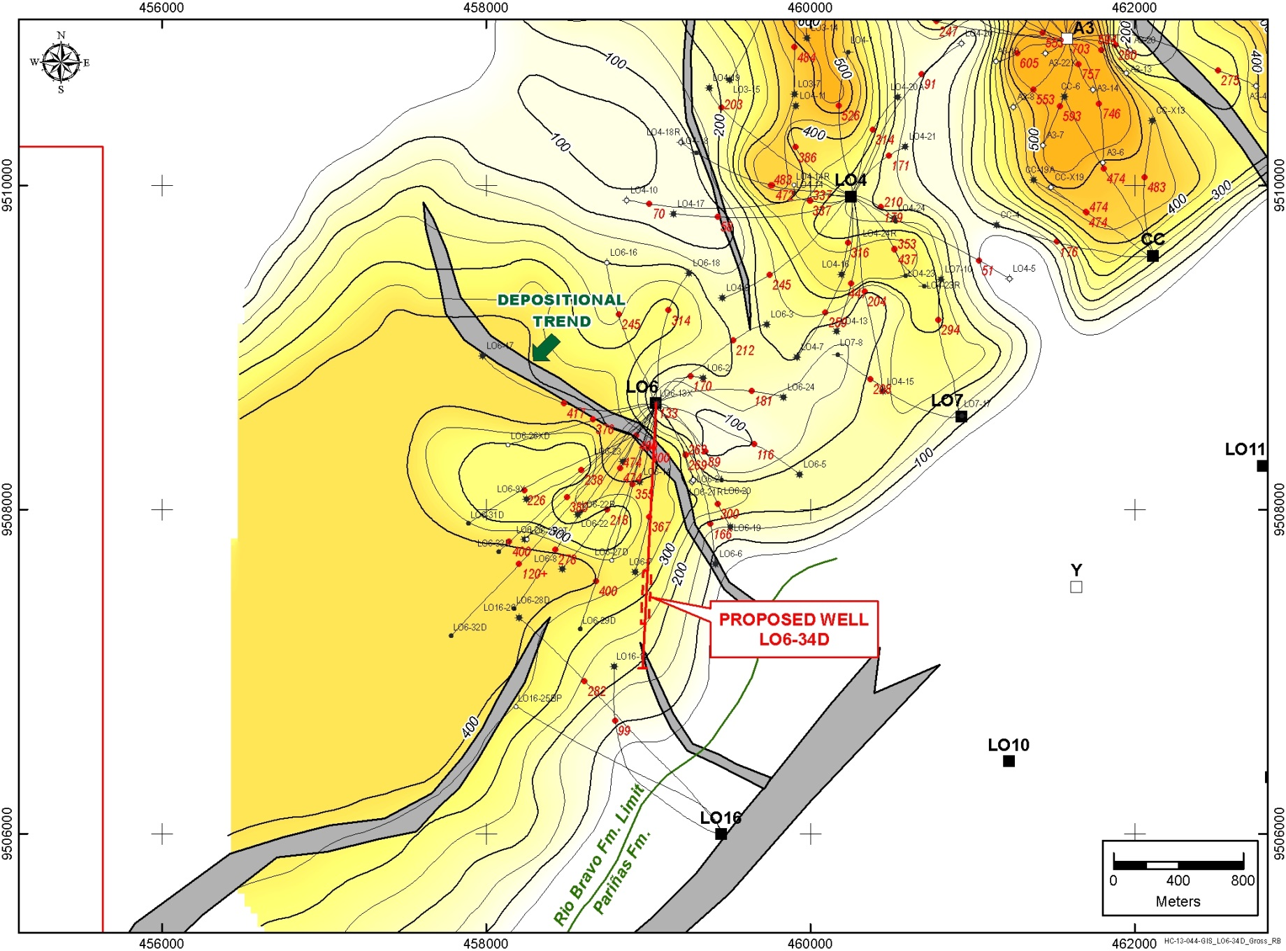
Z-2B LOBITOS FIELD
RIO BRAVO FM. - GROSS SAND MAP
C. Canales / E. Coronado Dec 2013
Figure 8

Slide 6
NW-SE STRATIGRAPHIC SECTION A-A’ SHOWING MOGOLLON FM.
Graphic Scale
H. Cornejo Dec 2013
NW
PROPOSED WELL
LO6-34D
SE
A
LO6-29D
LO6-27D
LO16-17
LO16-9
LO16-16
A´
MOGOLLON
IPR: 834 BOPD
Current Prod.:697 BOPD
CUM. PROD. 19 MBO ( MOG/RB)
10/2013
IPR: 219 BOPD
Current Prod.:134 BOPD
CUM. PROD. 21 MBO (Mog.)
07/2013
IPR: 155 BOPD
Current Prod.: 6 BOPD
CUM. PROD. 184 MBO (Mog.)
07/89
IPR: 167 BOPD
Current Prod.: 8 BOPD
CUM. PROD. 60 MBO (Mog.)
07/94
IPR: 290 BOPD
Current Prod.: 18 BOPD
CUM. PROD. 190 MBO (Mog.)
02/95
A
A’
PROPOSED WELL
LO6-34D
Figure 9

Slide 7
W-E STRATIGRAPHIC SECTION B-B’ RIO BRAVO FM
Graphic Scale
H. Cornejo Dec 2013
W
PROPOSED WELL
LO6-34D
E
LO6-33D
LO6-32D
LO6-28D
LO6-29D
LO6-7
B
B´
RIO BRAVO FM.
RIO BRAVO SHALY SECTION
Well on completion
11/2013
IPR: 273 BOPD
Current Prod. 8 BOPD
CUM. PROD. 308 MBO (RB)
01/85
LO6-34D
RB Projected
IPR: 624 BOPD
Current Prod. 180 BOPDXF
CUM. PROD. 38 MBO ( RB)
05/2013
IPR: 302 BOPD
Current Prod. 122 BOPD
CUM. PROD. 38 MBO ( RB)
05/2013
IPR: 834 BOPD
Current Prod.:697 BOPD
CUM. PROD. 19 MBO ( MOG/RB)
10/2013
B
B’
Figure 10

